Slide 1
SIC030 - PPT - SESI ke 13 Sistem Perdagangan Elektronik
Order Fulfillment, Content Management,
and Other Support Services
M HANIF JUSUF ST MKOM

Slide 2
Learning Objectives
Describe the role of support services in EC.
Define EC order fulfillment and describe its process.
Describe the major problems of EC order fulfillment.
Describe various solutions to EC order fulfillment problems.

Slide 3
Learning Objectives (cont.)
Describe content issues and management of EC sites.
Describe other EC support services.
Discuss the drivers of outsourcing support services and the use of ASPs.

Slide 4
How Bikeworld Fulfills Orders
The Problem
BikeWorld is known for its high-quality bicycles and components, expert advice, and personalized service
The company opened its Web site (bikeworld.com) in February 1996, hoping it would keep customers from using out-of-state mail-order houses

Slide 5
How Bikeworld Fulfills Orders (cont.)
BikeWorld encountered the problems of fulfillment and after-sale customer service
Sales over the Internet steadily increased
The time spent processing orders, manually shipping packages, and responding to customers’ order status inquiries overwhelmed the small company

Slide 6
How Bikeworld Fulfills Orders (cont.)
The Solution
BikeWorld outsourced its order fulfillment to FedEx
FedEx offered:
Reasonably priced quality express delivery
Exceeded customer expectations
Automated the fulfillment process

Slide 7
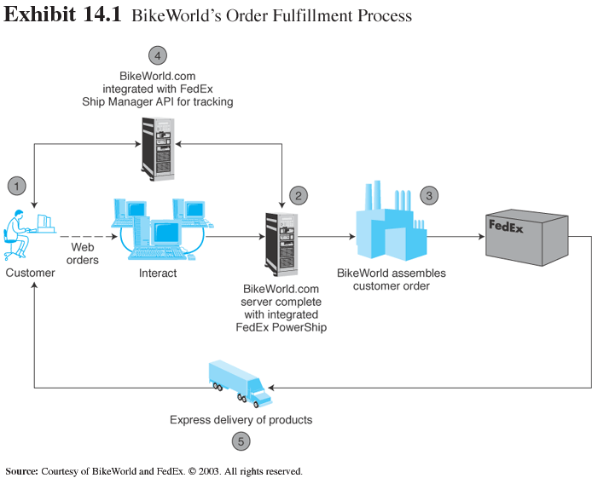
How Bikeworld Fulfills Orders (cont.)

Slide 8
How Bikeworld Fulfills Orders (cont.)
The Results
Four years after going online, sales volume has more than quadrupled and business is consistently profitable
BikeWorld has:
A fully automated and scalable fulfillment system
Access to real-time order status, enhancing customer service and leading to greater customer retention
The ability to service customers around the globe

Slide 9
How Bikeworld Fulfills Orders (cont.)
What we can learn…
Like many other e-tailers, BikeWorld had neither the experience nor the resources to fulfill the orders it generated online
Its solution was to outsource the job to FedEx, a major EC logistics company

Slide 10
Order Fulfillment and Logistics
Fulfillment and delivery to customers’ doors are the sticky parts of EC, factors responsible are:
an inability to accurately forecast demand
ineffective e-tailing supply chains
in “pull” operations (EC) orders are frequently a customized

Slide 11
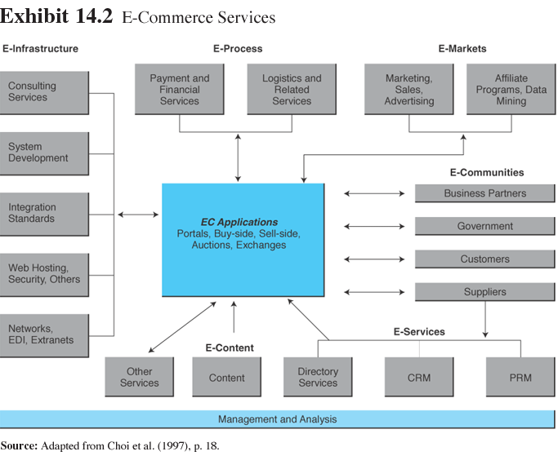
Order Fulfillment and Logistics (cont.)

Slide 12
Order Fulfillment and Logistics (cont.)
Order fulfillment: All the activities needed to provide customers with ordered goods and services, including related customer services

Slide 13
Order Fulfillment and Logistics (cont.)
Back-office operations: The activities that support fulfillment of sales, such as accounting and logistics
Front-office operations: The business processes, such as sales and advertising, that are visible to customers

Slide 14
Order Fulfillment and Logistics (cont.)
Logistics: The operations involved in the efficient and effective flow and storage of goods, services, and related information from point of origin to point of consumption

Slide 15
Order Fulfillment Process
EC order fulfillment process
Making sure the customer will pay
Checking for in-stock availability
Arranging shipments
Insurance
Production

Slide 16
Order Fulfillment Process (cont.)
Plant services
Purchasing and warehousing
Contacts with customers
Returns
Reverse logistics: The movement of returns from customers to vendors

Slide 17
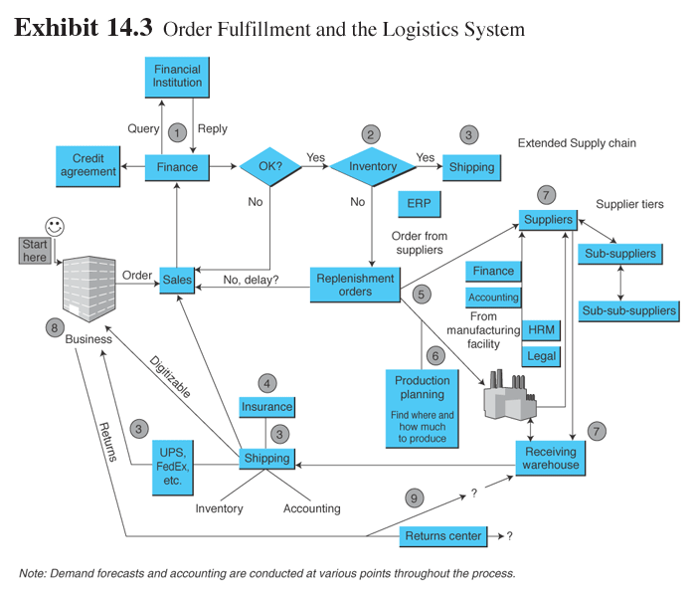
Order Fulfillment and Logistics (cont.)

Slide 18
Order Fulfillment and Logistics (cont.)
What services do customers need?
Customer preferences
Types of service
During shopping
During buying
After the order is placed
After the item is received

Slide 19
Order Fulfillment and Logistics (cont.)
Problem resolution
Shipping options
Fraud protection
Order status tracking, order status, and updates
Developing customer relationships

Slide 20
Order Fulfillment and Logistics (cont.)
E-logistics: The logistics of EC systems, typically involving small parcels sent to many customers’ homes
Traditional logistics deals with movement of large amounts of materials to a few destinations (retailers, stors)

Slide 21
Problems in Order Fulfillment
Typical supply chain problems
inability to deliver products on time
high inventory costs
quality problems
shipments of wrong products, materials, and parts
the cost to expedite operations or shipments is high

Slide 22
Problems in Order Fulfillment (cont.)
Demand forecasting determines appropriate inventories of finished goods at various points in the supply chain
It is necessary to forecast the demand for the components and materials required for fulfilling customized orders

Slide 23
Problems in Order Fulfillment (cont.)
Why supply chain problems exist
Problems along the EC supply chain stem from uncertainties and from the need to coordinate several activities, internal units, and business partners
The major source of the uncertainties in EC is the demand forecast

Slide 24
Problems in Order Fulfillment (cont.)
Demand is influenced by:
consumer behavior
economic conditions
competition
prices
weather conditions
technological developments
consumer confidence

Slide 25
Problems in Order Fulfillment (cont.)
Demand is influenced by (cont.):
variable delivery times depending on factors from machine failures to road conditions
quality problems of materials and parts
labor troubles

Slide 26
Solutions for Order Fulfillment Problems
Third-party logistics (3PL) suppliers: External, rather than inhouse, providers of logistics services

Slide 27
Solutions for Order Fulfillment Problems (cont.)
Improvements in the order process
Order taking can be done via EDI, EDI/Internet, Internet, or an extranet, and it may be fully automated
In B2B, orders are generated and transmitted automatically to suppliers when inventory levels fall below certain threshold resulting in:
fast, inexpensive, and more accurate order-taking process

Slide 28
Solutions for Order Fulfillment Problems (cont.)
In B2C, Web-based ordering using electronic forms
expedites the process
makes the process more accurate (intelligent agents can check the input data and provide instant feedback)
reduces processing costs for sellers

Slide 29
Solutions for Order Fulfillment Problems (cont.)
Order-taking improvements can also take place within an organization
Implementing linkages between order-taking and payment systems can also be helpful in improving order fulfillment

Slide 30
Solutions for Order Fulfillment Problems (cont.)
Inventory management improvements
Automated warehouses
Automated warehouses may include robots and other devices that expedite the pick-up of products
Example: Fingerhut

Slide 31
Solutions for Order Fulfillment Problems (cont.)
Speeding deliveries
Same day, even same hour, delivery
efulfillmentservice.com and owd.com
created networks for rapid distribution of products
offer a national distribution system across the U.S. in collaboration with shipping companies such as FedEx and UPS

Slide 32
Same Day Deliveries
Supermarket deliveries
Buyers need to be home at certain times to accept the deliveries
Distribution systems for such enterprises are critical
Successful online grocers are Woolworths of Australia and GroceryWorks
Failed delivery company—WebVan

Slide 33
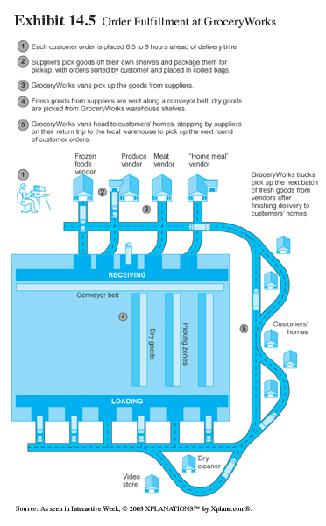
Same Day Deliveries (cont.)

Slide 34
Solutions for Order Fulfillment Problems (cont.)
Partnering efforts and outsourcing logistics
EC companies partner with UPS or FedEx
MailBoxes Etc. (now a subsidiary of UPS) with Innotrac Corp (fulfillment services),, AccuShip.com (logistics firm)

Slide 35
Solutions for Order Fulfillment Problems (cont.)
Handling returns
Return the item to the place where it was purchased
Separate the logistics of returns from the logistics of delivery
Completely outsource returns
Allow the customer to physically drop the returned item at a collection station

Slide 36
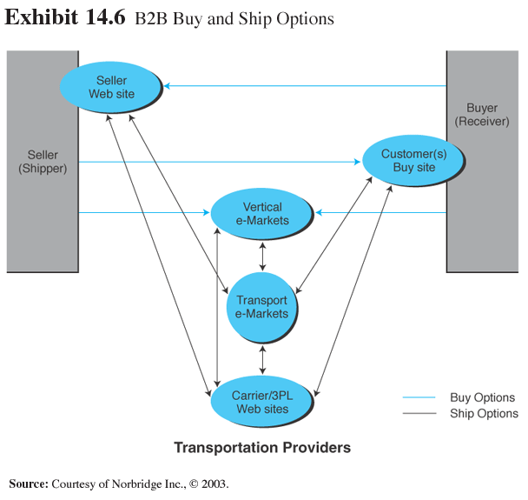
Solutions for Order Fulfillment Problems (cont.)

Slide 37
Solutions for Order Fulfillment Problems (cont.)
Using e-marketplaces and exchanges to ease order fulfillment problems in B2B
Company-centric marketplace can solve several supply chain problems
An extranet smoothes the supply chain and delivers better customer service
A vertical exchange connects thousands of suppliers

Slide 38
Solutions for Order Fulfillment Problems (cont.)
Innovative fulfillment strategies
Merge-in-transit: Logistics model in which components for a product may come from two different physical locations and are shipped directly to customer’s location
merge-in-transit

Slide 39
Solutions for Order Fulfillment Problems (cont.)
Rolling warehouse: Logistics method in which products on the delivery truck are not preassigned to a destination, but the decision about quantity to unload at each destination is made at the time of unloading

Slide 40
Solutions for Order Fulfillment Problems (cont.)
Leveraged shipments: planning shipments based on a combination of size (or value) of the order and geographical location.
Delivery-value density: is a decision support tool that helps determine whether it is economical to deliver goods to a neighborhood area in one trip

Slide 41
Content Generation, Syndication, Delivery, and Management
Dynamic Web content: Content at a Web site that needs to be changed continually to keep it up to date
Measuring content quality
metrics to control the quality of online content
meet privacy requirements, copyright and other legal requirements, language translation needs

Slide 42
Content Generation, Syndication, Delivery, and Management (cont.)
Pitfalls of content management
Picking content management software before developing solid requirements and business case
Not getting a clear mandate from the top to proceed
Underestimating integration and professional service needs

Slide 43
Content Generation, Syndication, Delivery, and Management (cont.)
Hiring inexperienced developers to integrate and extend the software
Depending entirely on an outside company to make changes to the system
Thinking your migration will be painless despite what the content management system provider tells you

Slide 44
Content Generation, Syndication, Delivery, and Management (cont.)
Web content management: The process of collecting, publishing, revising, and removing content from a Web site to keep content fresh, accurate, compelling, and credible

Slide 45
Content Generation, Syndication, Delivery, and Management (cont.)
Content delivery networks
Update content, improve the quality of the site, increase consistency, control content, and decrease the time needed to create or maintain a site

Slide 46
Content Generation, Syndication, Delivery, and Management (cont.)
Catalog content management
Do it yourself
Let the suppliers do it
Buy the content from an aggregator
Subscribe to a vertical exchange
Outsource to a full-service Internet exchange

Slide 47
Content Generation, Syndication, Delivery, and Management (cont.)
Content translation to other languages
The primary problems with language customization
cost
speed
It takes a human translator about a week to translate a medium-size Web site into just one language

Slide 48
Content Translation (cont.)
WorldPoint Passport (worldpoint.com) solution allows Web developers to create a Web site in one language and to deploy it in several other languages
Automatic translation can be inaccurate

Slide 49
Content Generation, Syndication, Delivery, and Management (cont.)
Content related vendors
Documentum (documentum.com)
Microsoft (microsoft.com)
Vignette (vignette.com)
Interwoven (interwoven.com)
Opentext (opentext.com)
Akamai (akamai.com)

Slide 50
Content Generation, Syndication, Delivery, Management (cont.)
Content maximization and streaming services
Media-rich content
Video clips
Music
Flash media
Major concern is the download time

Slide 51
Other EC Support Services
Consulting services
Experts in guiding their clients through the maze of legal, technical, strategic, and operational problems and decisions that must be addressed in order to ensure success

Slide 52
Consulting Services (cont.)
Provide expertise in the area of EC, but not in traditional business (specialized expertise)
Traditional consulting company that maintains divisions that focus on EC
Select experienced and competent consulting firm, with sufficient synergies with the client firm

Slide 53
Other EC Support Services (cont.)
Directory services
list companies by categories
provide links to companies
provide special search engines
value-added services like matching buyers and sellers are available

Slide 54
Other EC Support Services (cont.)
Newsletters
Many companies (Ariba, Intel) issue corporate newsletters and e-mail them to people request them
Use software to send online press releases to thousands of editors

Slide 55
Other EC Support Services (cont.)
Search engines and news aggregators
Search engines can be used to find information about B2B
Moreover.com
directory.google.com
iEntry.com

Slide 56
Other EC Support Services (cont.)
More EC support services
Trust services
Trademark and domain names
Digital photos
Global business communities
Access to commercial databases

Slide 57
Other EC Support Services (cont.)
Online consulting
Knowledge management
Client matching
E-business rating sites
Encryption sites
Web research services
Coupon-generating sites

Slide 58
Outsourcing EC Support Services
Why outsource EC support services?
Early businesses were vertically integrated, they:
owned or controlled their own sources of materials
manufactured components
performed final assembly
managed the distribution and sale of their products to consumers

Slide 59
Outsourcing EC Support Services (cont.)
Major reasons for outsourcing
A desire to concentrate on the core business
The need to have services up and running rapidly
Lack of expertise for many of the required support services

Slide 60
Outsourcing EC Support Services (cont.)
The inability to have the economy of scale enjoyed by outsourcers
Inability to keep up with rapidly fluctuating demands if an in-house option is used
Too many required services

Slide 61
Outsourcing EC Support Services (cont.)
Typical process of developing and managing EC applications
EC strategy formulation
Application design
Building (or buying) the application
Hosting, operating, and maintaining the EC site

Slide 62
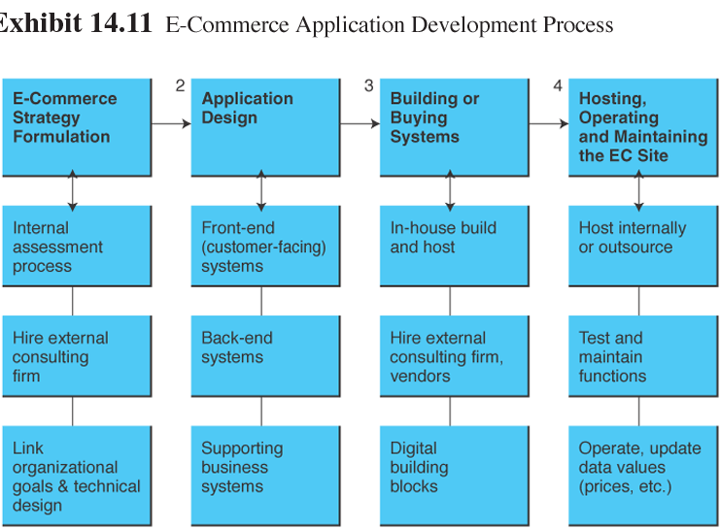
Outsourcing EC Support Services (cont.)

Slide 63
Outsourcing EC Support Services (cont.)
Services for creating and operating electronic storefronts:
Internet malls
ISPs
Telecommunication companies
Software houses
Outsourcers and others

Slide 64
Outsourcing EC Support Services (cont.)
Application service provider (ASP): An agent or vendor who assembles the functions needed by enterprises and packages them with outsourced development, operation, maintenance, and other services

Slide 65
Outsourcing EC Support Services (cont.)
Leasing from ASPs
SMEs in-house—development and operation of EC applications can be time-consuming and expensive
Concern about the adequacy of the protection offered by ASPs against hackers etc.
Leased software often does not provide the perfect fit for the desired application

Slide 66
Managerial Issues
Have we planned for order fulfillment?
How should we handle returns?
Do we want alliances in order fulfillment?
What EC logistics applications would be useful?

Slide 67
Managerial Issues (cont.)
What is the best e-content strategy?
Should we provide content translation?
EC consultants are expensive. Should we use them?
Should we outsource EC services?

Slide 68
Summary
The order fulfillment process
payment verification
inventory checking
shipping arrangement, insurance
production (or assembly)
plant services
purchasing
customer contacts
return of products

Slide 69
Summary (cont.)
Problems in order fulfillment
Uncertainties in demand and potential delays in supply and deliveries
Lack of coordination and information sharing among business partners

Slide 70
Summary (cont.)
Solutions to order fulfillment problems
Automating order taking
Smoothing the supply chain
supported by software that facilitates
correct inventories
coordination along the supply chain
appropriate planning and decision making

Slide 71
Summary (cont.)
EC content issues and management
Critical for branding and advertising
Major content issues are:
the use of vendors
translation to other languages
maintenance (keeping it up-to-date)
maximization and streamlining of its delivery

Slide 72
Summary (cont.)
Other support services
Consulting services
Directory services
Infrastructure providers
Support services should be coordinated and integrated

Slide 73
Summary (cont.)
Outsourcing EC services and using ASPs
Lack of time and expertise forces companies to outsource
Using ASPs is not inexpensive nor risk-free

Slide 74

Selesai

